Slide 1
DIGITAL ELECTRONICS-UNIT-2
Simplification of Boolean Equations
Dr R THILAK KUMAR

Slide 2
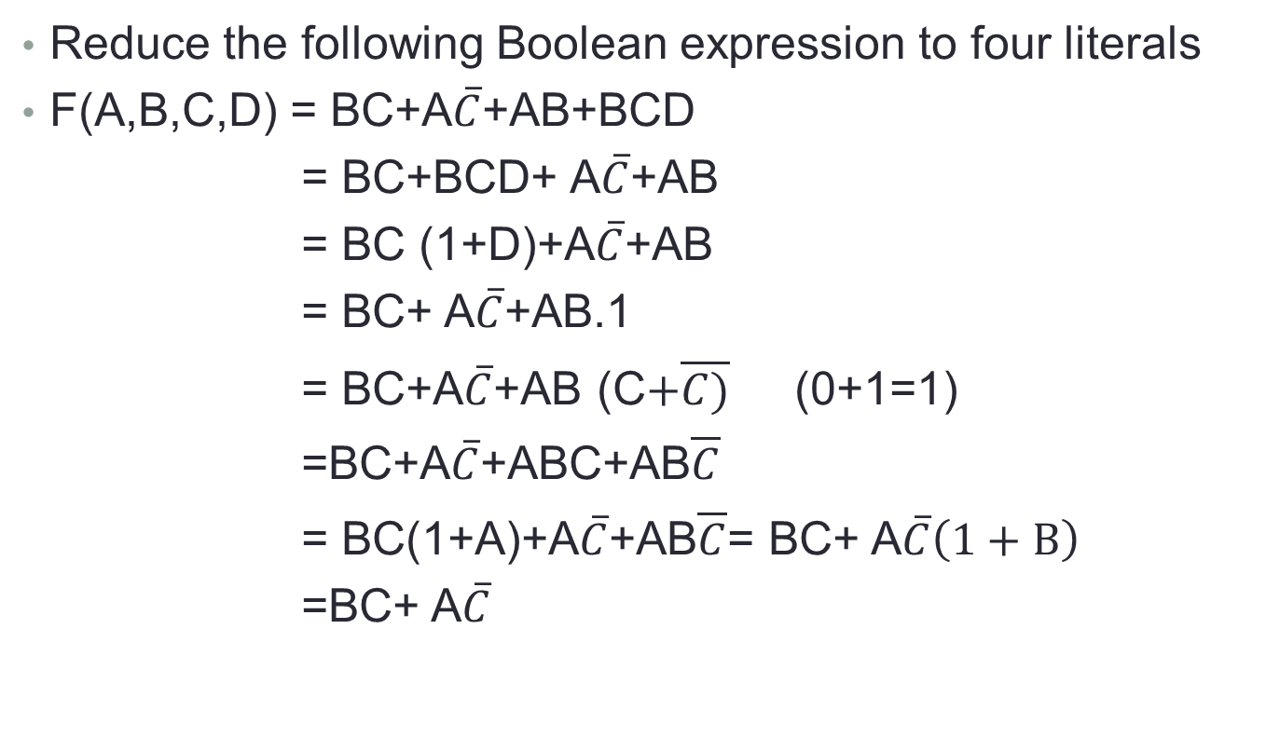
Reduce the following Boolean expression to four literals
F(A,B,C,D) = BC+A$\overline{C}$+AB+BCD
= BC+BCD+ A$\overline{C}$+AB
= BC (1+D)+A$\overline{C}$+AB
= BC+ A$\overline{C}$+AB.1
= BC+A$\overline{C}$+AB (C$+\overline{C)}$ (0+1=1)
=BC+A$\overline{C}$+ABC+AB$\overline{C}$
= BC(1+A)+A$\overline{C}$+AB$\overline{C}$= BC+ A$\overline{C}\left(1+B\right)$
=BC+ A$\overline{C}$

Slide 3
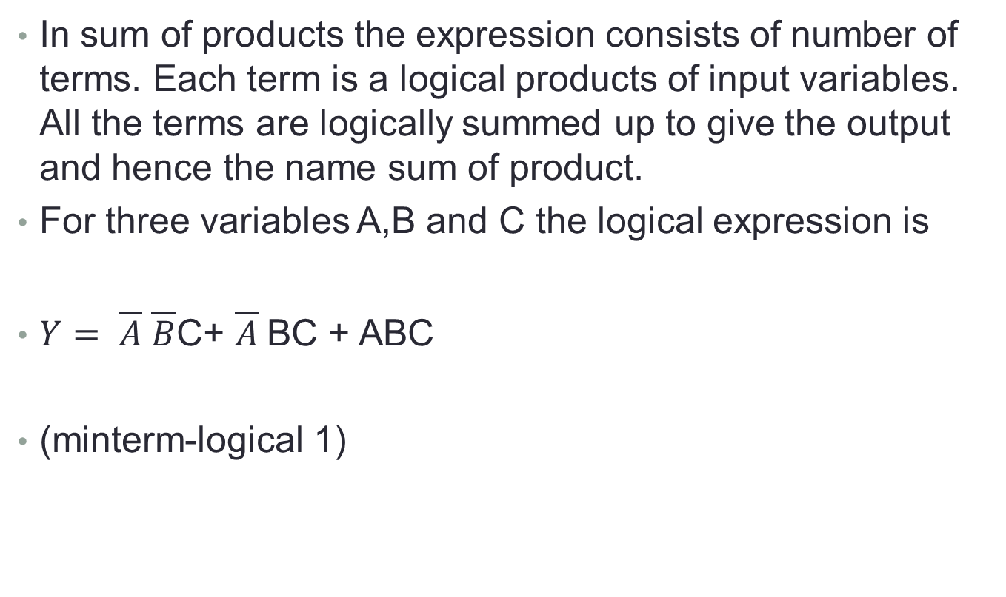
SOP-Sum of Products
In sum of products the expression consists of number of terms. Each term is a logical products of input variables. All the terms are logically summed up to give the output and hence the name sum of product.
For three variables A,B and C the logical expression is
$Y= \overline{A} \overline{B}$C+ $\overline{A}$BC + ABC
(minterm-logical 1)
C

Slide 4

A | B | C | Y
0 | 0 | 0 | 0
0 | 0 | 1 | 1
0 | 1 | 0 | 0
0 | 1 | 1 | 0
1 | 0 | 0 | 0
1 | 0 | 1 | 1
1 | 1 | 0 | 1
1 | 1 | 1 | 1
$Y=\overline{A} \overline{B}\text{C}$+ A$\overline{B}$C+AB $\overline{C}$+ABC

Slide 5
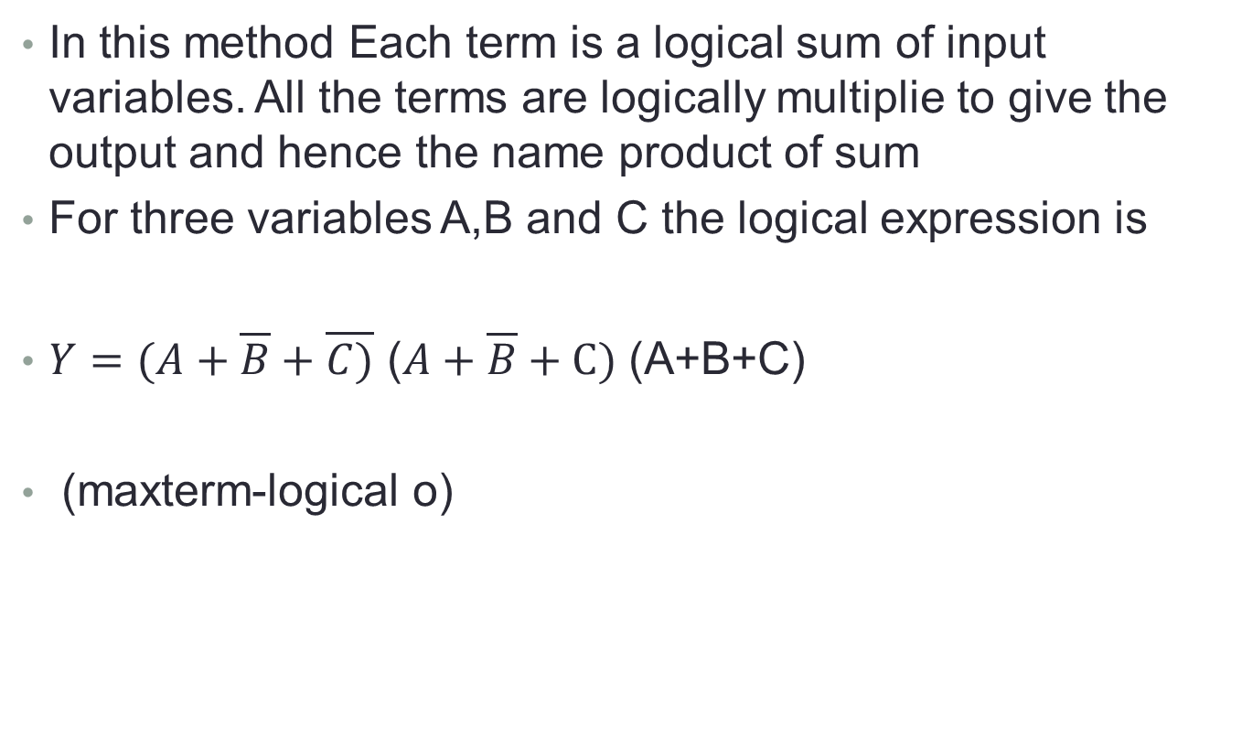
POS-Product of Sum
In this method Each term is a logical sum of input variables. All the terms are logically multiplie to give the output and hence the name product of sum
For three variables A,B and C the logical expression is
$Y=(A+\overline{B}+\overline{C)}$ ($A+\overline{B}+C)$ (A+B+C)
(maxterm-logical o)

Slide 6
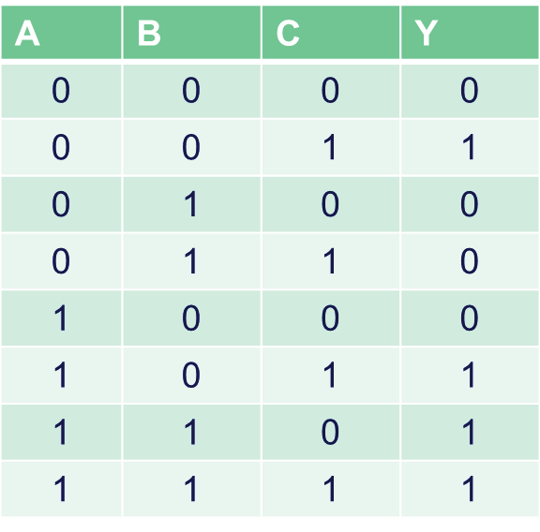
$Y=$(A+B+C) ( $A+\overline{B}+$C) (A+$\overline{B}$ +$\overline{C}$) ($\overline{A}$+B+C)

Slide 7
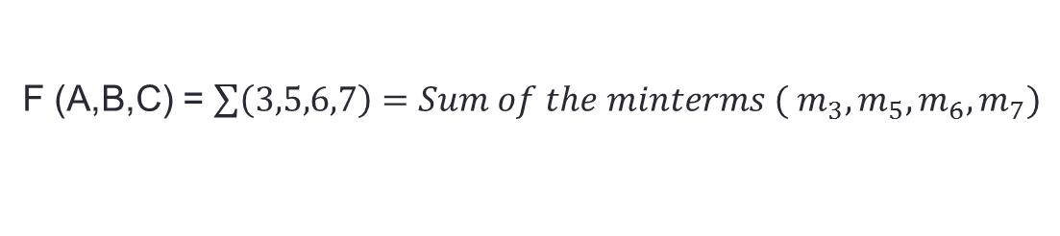
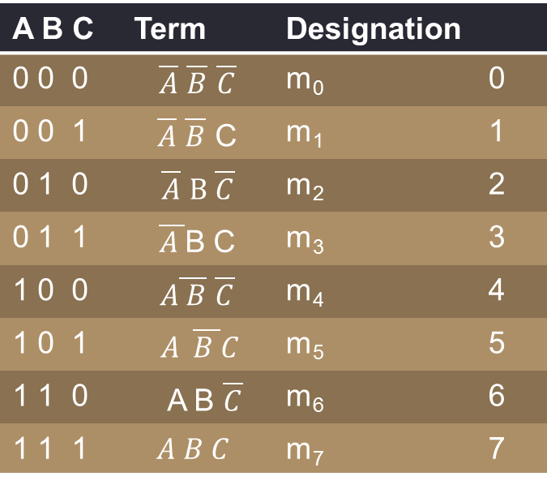
minterm
A B C | Term | Designation
0 0 0 | $\overline{A}$ $\overline{B}$ $\overline{C}$ | m₀ | 0
0 0 1 | $\overline{A}$ $\overline{B}$ C | m₁ | 1
0 1 0 | $\overline{A}$ $B \overline{C}$ | m₂ | 2
0 1 1 | $\overline{A }$B C | m₃ | 3
1 0 0 | $A\overline{ B}$ $\overline{C}$ | m₄ | 4
1 0 1 | $$A \overline{B }C$$ | m₅ | 5
1 1 0 | A B $\overline{C}$ | m₆ | 6
1 1 1 | $$A B C$$ | m₇ | 7
F (A,B,C) = $\sum{\left(3,5,6,7\right)=Sum of the minterms ( m_{3},m_{5},m_{6},m_{7})}$

Slide 8
K-Map
Developed by Karnaugh in 1953
Used to simplify the Boolean expressions
We can draw the pictorial representations for
2 variables
3 variables
4 variables
To draw the K-map 2^{n} cells required

Slide 9
K-Mapr-2 variable
                B 0 1
              A
              0
              1

Slide 10
3-variable
AB C 0 1
A BC 00 01 1 1 10
00
0 01
1
11
10

Slide 11
4-variable
  CD
  AB 00 01 11 10
  00
  01
  11
  10

